Slide 1






SUMMER SCHOOL FOR STUDENTS
„ZOONOSES”
25th – 29th April 2022
Dubrovnik, Croatia

Slide 2
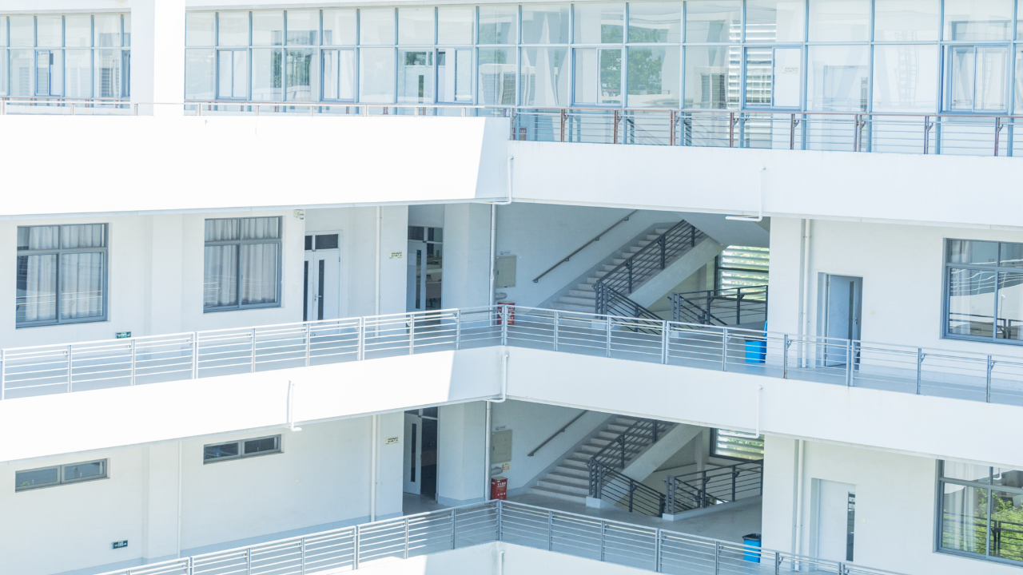


SUMMER SCHOOL FOR STUDENTS
„ZOONOSES”
25th – 29th April 2022
Dubrovnik, Croatia

Slide 3


SUMMER SCHOOL FOR STUDENTS
„ZOONOSES”
25th – 29th April 2022
Dubrovnik, Croatia
Topics
of Summer School
24.04. Sunday – arrival of students
Day 1 (Mon 25.04.) – WILDLIFE DISEASES –
CONSERVATION MEDICINE
Day 2 (Tue 26.04.) – ANIMAL ETHICS &
ZOONOSES IN LIVESTOCK PRODUCTION SYSTEMS
Day 3 (Wed 27.04.) – HUMAN ASPECTS OF
ZOONOSES
Day 4 (Thu 28.04.) – VIRAL ZOONOSES AND ONE
HEALTH APROACH
Day 5 (Fri 29.04.) – BACTERIAL ZOONOSES
30.04. Saturday – Social programme & departure
Some changes in the Programme are possible concerning the epidemiological situation

Slide 4



SUMMER SCHOOL FOR STUDENTS
„ZOONOSES”
25th – 29th April 2022
Dubrovnik, Croatia
8.30 – 9.30 Breakfast
9.30 – 11.00 Lectures
11.00 – 11.30 Coffee break
11.30 – 12.30 Lectures
12.30 – 14.30 Lunch
14.30 – 17.30 Practical work
Free time + preparation for next day

Slide 5

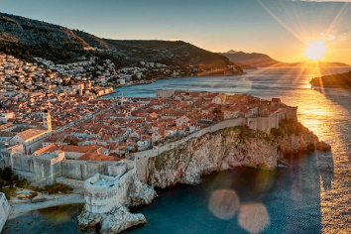

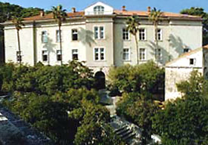
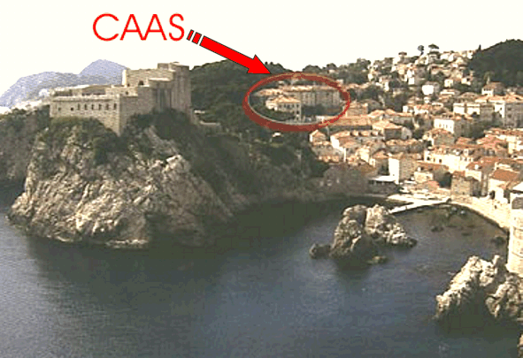
SUMMER SCHOOL FOR STUDENTS
„ZOONOSES”
25th – 29th April 2022
Dubrovnik, Croatia
Venue of Summer School
CENTRE FOR ADVANCED ACADEMIC STUDIES
(CAAS) DUBROVNIK
Don Frana Bulica 4 - 20000 Dubrovnik - Croatia
http://www.caas.unizg.hr/

Slide 6



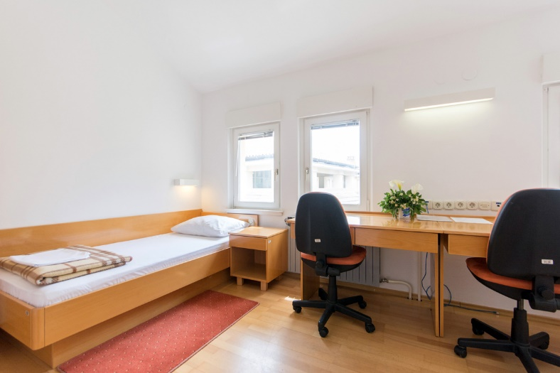
SUMMER SCHOOL FOR STUDENTS
„ZOONOSES”
25th – 29th April 2022
Dubrovnik, Croatia
CENTRE FOR ADVANCED ACADEMIC STUDIES (CAAS) DUBROVNIK
Don Frana Bulica 4 - 20000 Dubrovnik – Croatia
http://www.caas.unizg.hr/
Single room – 40 EUR/ per person
Double room – 35 EUR/ per person
Two bed Apartments – 40 EUR/ per day + (additional bed) – 15 EUR
Local taxes – 1,5 EUR per day

Slide 7
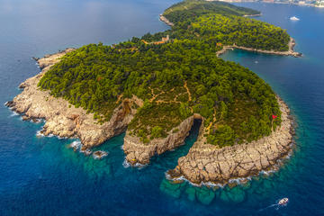
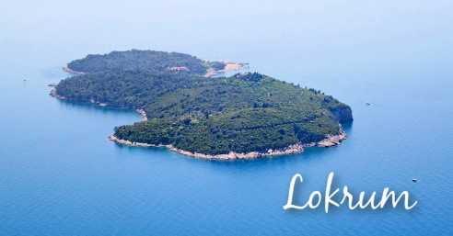
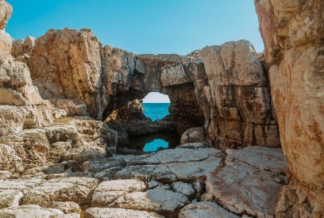
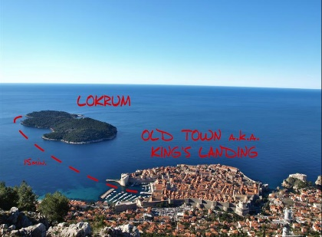
SUMMER SCHOOL FOR STUDENTS
„ZOONOSES”
25th – 29th April 2022
Dubrovnik, Croatia
Social programme
The eternally green islet of romantic beauty, positioned right off the coast of Dubrovnik is a true oasis of peace, and one of the most attractive excursion sights for residents of Dubrovnik and its visitors. With its maintained bathing sites and bays, view of the sunny open sea, extensive pine woods, lush subtropical vegetation, and with its old Benedictine monastery and walking trails along the shaded alleys, the islet gives an unforgettable impression.
In the bosom of the fragrant park is the former Benedictine monastery (from the 12th century), closed down during Napoleon's occupation. Later, the monastery and the islet as a whole came into possession of the Habsburg Archduke Maximilian and became his summer residence in 1859. Maximilian renovated the monastery in the neo-Gothic style and built a castle in the shape of a tower. Following Maximilian's tragic death in Mexico, the islet changed hands several times, and today is a protected nature park.
During the French occupation, the French erected a citadel called "Fort Royal" at the highest point on the island, which is a lookout point today, offering the loveliest view of Lokrum and the whole of Dubrovnik.
A special attraction on Lokrum is its small lake, called the "dead sea". The castle today is home to the Biological Institute of the Croatian Academy of Arts and Sciences and the Natural Sciences Museum, with its valuable collections and memorial collection of world renowned Dubrovnik mathematician, atomist and astronomer Ruđer Bošković (18th century). Transport to Lokrum is organized via tourist boats from the Dubrovnik old town port.

Slide 8
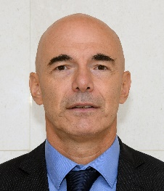
SUMMER SCHOOL FOR STUDENTS
„ZOONOSES”
25th – 29th April 2022
Dubrovnik, Croatia
Prof Alen Slavica, DVM, MSc, PhD,
Faculty of Veterinary Medicine
University of Zagreb
Vjekoslav Heinzel str. 55
10 000 Zagreb -Croatia
Tel: +385 1 2390 156; +385 1 2390 260
Mobile: +385 91 5590 758; +385 91 2390 260
E-mail: slavica@vef.hr
rpurgar@vef.hr
Web: www.vef.unizg.hr/szd2022
Additional information:
Prof
Alen Slavica

